Slide 1

INTERNET PROGRAMMING II
CHAPTER ONE
SERVER SIDE SCRIPTING BASICS
Email:ibmbegna@gmail.com
visit: https://begnafrique.wordpress.com/

Slide 2
Contents
€ Introduction to PHP
€ How to run php file on server?
€ PHP Variables
€ PHP Data Types
€ PHP Operators
€ Conditional Statements
€ PHP Arrays
€ PHP Looping
€ PHP Functions
2

Slide 3
Introduction to PHP
PHP is a server-side scripting language.
Server side script language is a technique used in web development which involves using script on a web server which produce a response customized for each users clients requests to the web site.
What is PHP?
PHP stands for PHP: Hypertext Preprocessor
PHP scripts are executed on the server
PHP supports many databases (MySQL, Informix, Oracle,
Sybase,
Solid,
PostgreSQL, Generic ODBC, etc.)
For our study we focus on XAMPP/XAMPP MYSQL)
PHP is an open source software
server (includes Apache and
□ PHP is free to download and use
3

Slide 4
What is a PHP File?
Cont..d
PHP files can contain text, HTML tags and scripts
PHP files are returned to the browser as plain HTML
PHP files have a file extension of ".php", ".php3", ".php4", ".php5" or ".phtml“ etc. but the first extension is the common one.

Slide 5
What is MySQL?
Cont..d
MySQL is a database server
MySQL is ideal for both small and large applications
MySQL supports standard SQL
MySQL compiles on a number of platforms
MySQL is free to download and use

Slide 6
PHP + MySQL
Cont..d
PHP combined with MySQL are cross-platform (possible to develop in Windows and serve on a Unix platform)
Why PHP?
PHP runs on different platforms (Windows, Linux, Unix, etc.)
PHP is compatible with almost all servers used today (Apache, IIS, etc.)
PHP is FREE to download from the official PHP resource: www.php.net
PHP is easy to learn and runs efficiently on the server side

Slide 7
PHP Syntax
PHP code is executed on the server, and the plain HTML result is sent to the browser.
Basic PHP Syntax
A PHP scripting block always starts with <?php and ends
with ?>.
A PHP scripting block can be placed anywhere in the document.
On servers with shorthand support enabled you can start a scripting block with <? and end with ?>.

Slide 8
Cont..d
For maximum compatibility, we recommend that you use the standard form (<?php)
rather than the shorthand form.
A PHP file normally contains HTML tags, just like an HTML file, and some PHP scripting code.
Below, we have an example of a simple PHP script which sends the text "Hello
World" to the browser:
<html>
<body>
<?php
echo "Hello World";
?>
</body>
</html>

Slide 9
Cont..d
Each code line in PHP must end with a semicolon (;).
The semicolon is a separator and is used to distinguish one set of instructions from another.
<?php
//This is a single line comment
/* This is
a multiple line comment
*/
?>

Slide 10
Cont..d
□ There are two basic statements to output text with PHP:
echo and print. In the example above we have used the
echo
statement to output the text "Hello World".
Note: The file must have a .php extension.
If the file has a .html extension, the PHP code will not be
executed.
Comments in PHP
In PHP, we use // to make a single-line comment or
/* and */ to make a large comment block. Example:

Slide 11

How to run php file on XAMPP server?
 | Step1: | XAMPP installation
 | Step2: | start Apache and MYSQL from XAMPP
 | Step3: | install Notepad++
 | Step4: | open any text editor (Note pad, Notepad++ etc.)
 | Step5: | write php program or code on text editor.
 | Step6: | save the file in XAMPP installation directory
or web root directory.

Slide 12
Default
C/XAMPP
Cont..d
XAMPP installation directory for windows is
□ Step7:
directory there is the directory and create folder
www directory and give any
in the XAMPP
open name.
□ Step8: note: save
all php file to the
folder you are
creating in step7 with .php extension name.
Step9: now, in your browser address bar, type the address: http:/localhost/folder_name/filename.php
Step10: if you are correctly follow the steps the result easily displayed on the browser.

Slide 13
PHP Variables
A variable is used to store information.
Variables in PHP
Variables are used for storing values, like text strings, numbers or
arrays.
When a variable is declared, it can be used over and over again in
your script.
All variables in PHP start with a $ sign symbol.
The correct way of declaring a variable in PHP:
$var_name = value;
Example:
<?php
$txt="Hello World!";
$?>x=16;

Slide 14
PHP is a Loosely Typed Language
□ In PHP, a variable does not need
to be declared
do not
before
have to correct
adding a value to it.
□ In the example above,
you see that you
tell PHP which data type the variable is.
□ PHP automatically converts
the variable to the
data type, depending on its value.
In a strongly typed programming language, you have to declare (define) the type and name of the variable before using it.
In PHP, the variable is declared automatically when you
use it.

Slide 15
Naming Rules for Variables
□ A variable name must start with a letter or an underscore
"_"
A variable name can only contain alpha-numeric
and underscores (a-z, A-Z, and _ )
A variable name should not contain spaces.
characters
□ If a variable name is more than one word, it
should be
separated with an underscore ($my_string),
or with
capitalization ($myString).

Slide 16
PHP Data Types
□ Variables | can | store | data | of | different | types, | and
different | data | types | can | do | different | things.
PHP supports the following data types:
String
Integer
Float (floating point numbers - also called double)
Boolean
Array
NULL

Slide 17
PHP String
A string is a sequence of characters, like "Hello world!".
A string can be any text inside quotes.
You can use single or double quotes:
Example
<?php
$x | = | "Hello | world!";
$y | = | 'Hello | world!';
echo $x; echo "<br>"; echo $y;
?>
17

Slide 18
PHP Integer
An integer data type is a non-decimal number between - 2,147,483,648 and 2,147,483,647.
Rules for integers:
An integer must have at least one digit
An integer must not have a decimal point
An integer can be either positive or negative
Integers can be specified in three formats: decimal (10-based),
hexadecimal (16-based) or octal (8-based)
18

Slide 19
In the following example $x is an integer.
Cont..d
□ The PHP var_dump() function returns the data type and
value:
Example
<?php
$x = 5985;
var_dump($x);
?>
19

Slide 20
PHP Boolean
A Boolean represents two possible states: TRUE or FALSE.
$x = true;
$y = false;
Booleans are often used in conditional testing.
PHP Array
An array stores multiple values in one single variable.
In the following example $cars is an array.
The position of array elements starts from 0 not 1
20

Slide 21
Example
Cont..d
<?php
$cars = array("Volvo","BMW","Toyota");
var_dump($cars);
echo $cars[0];
?>
21

Slide 22
PHP NULL Value
Null is a special data type which can have only one value: NULL.
A variable of data type NULL is a variable that has no value assigned to it.
Tip: If a variable is created without a value, it is
automatically assigned a value of NULL.
Variables can also be emptied by setting the value to NULL:
Example
<?php
$x = "Hello world!";
$x = null; var_dump($x);
?>
22

Slide 23
PHP Strings
A string is a sequence of characters, like "Hello world!".
Get The Length of a String
The PHP strlen() function returns the length of a string.
The example below returns the length of the string "Hello
world!":
<?php
echo strlen("Hello world!"); // outputs 12
?>

Slide 24
Count The Number of Words in a String
Cont..d
The PHP str_word_count() function counts the number of words in a string:
<?php
echo str_word_count("Hello world!"); // outputs 2
?>
Reverse a String
The PHP strrev() function reverses a string:
Example
<?php
echo strrev("Hello world!"); // outputs !dlrow olleH
?>

Slide 25
Search For a Specific Text Within a String
□ The PHP strpos() function searches for
a specific text
within a string.
□ If a match is found, the function returns position of the first match. If no match
the character is found, it
will return NULL.
□ The example below searches for the text "world" in the string "Hello world!":
<?php echo strpos("Hello world!", "world");
? >
// outputs 6
25

Slide 26
The output of the code above will be: 6.
Tip: The first character position in a string is 0 (not 1). Replace Text Within a String
Cont..d
The PHP str_replace() function replaces some characters
with some other characters in a string.
The example below replaces the text "world" with "Dolly": Example
<?php
echo str_replace("world", "Dolly", "Hello world!"); // outputs Hello Dolly!
?>

Slide 27
The Concatenation Operator
□ There is only one string operator in PHP.
The concatenation operator dot(.) string values together.
To concatenate two string variables together, use the concatenation operator dot(.): example:
<?php
$txt1=“I’m interested!";
$txt2=“with php!";
echo $txt1 . " " . $txt2;
?>
is used to put two

Slide 28

PHP Constants
□ Constants are like variables except that once they are defined
 | they cannot be changed or undefined. A constant is an identifier (name) for a simple value.
 | The value cannot be changed during the script.
A | valid constant name starts with a letter or underscore.
 | No $ sign before the constant name.
Note: Unlike variables, constants are automatically global across
the entire script.
Create a PHP Constant
□ To create a constant, use the define() function.

Slide 29
Syntax
define(name, value, case-insensitive)
Parameters:
Name: Specifies the name of the constant
Value: Specifies the value of the constant
□ The example below creates a constant with a case-sensitive name: Example
<?php
define("GREETING", "Hello IT!");
echo GREETING;
?>
Case-insensitive: | Specifies whether | the | constant | name | should | be
case-insensitive. | Default is false

Slide 30
Cont. …
Example
<?php
define("GREETING", " Hello IT!", true);
echo greeting;
?>
Constants are Global
Constants are automatically global and can be used across the
entire script.
The example below uses a constant inside a function, even if it is defined outside the function:

Slide 31
Cont..
<?php
define("GREETING", "Welcome to MeU!");
function myTest()
{
echo GREETING;
}
myTest();
?>

Slide 32
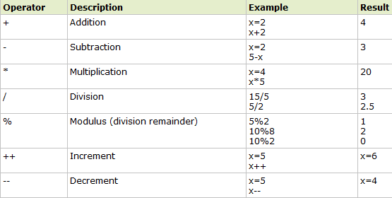
PHP Operators
Operators are used to operate on values.
PHP Operators
This section lists the different operators used in PHP.
Arithmetic Operators

Slide 33
Example
<?php
$x = 10;
$y = 6;
echo($x+$y)."<br>"; //output 16
echo($x-$y)."<br>"; //output 4
echo($x*$y)."<br>"; //output 60
echo($x/$y)."<br>"; //output 1.67
echo($x%$y)."<br>"; //output 4
echo echo echo
++$x."<br>";
--$y."<br>";
$x++."<br>";
// output 11
// output 5
// output 11
// output 5
echo $y--."<br>";
?>

Slide 34
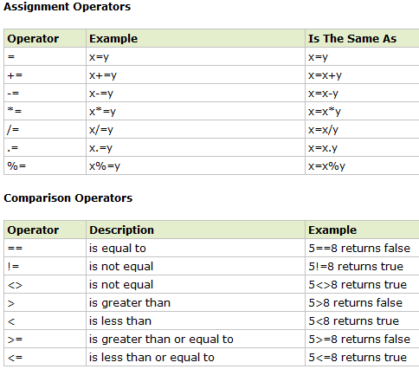
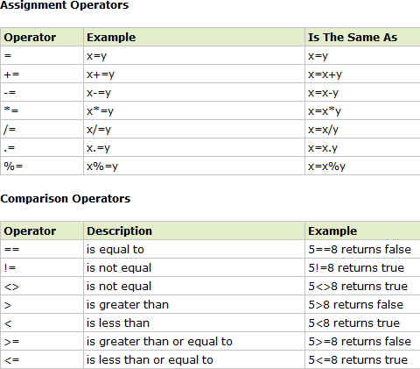

Slide 35
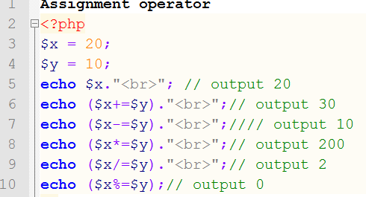
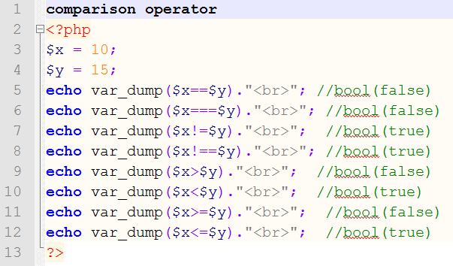
Example

Slide 36
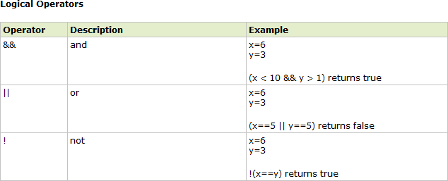

Slide 37
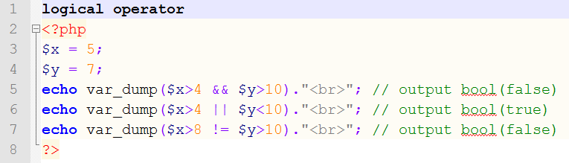
Example

Slide 38
Conditional Statements
Conditional statements are used to perform different actions based on different conditions.
In PHP we have the following conditional statements:
if statement - use this statement to execute some code only if a specified condition is true
if...else statement - use this
statement to and another
execute some code if the
code if a condition is true
condition is false
if...elseif....else statement
- use this statement to
select one of several blocks of code to be executed
switch statement - use this statement to select one of many blocks of code to be executed

Slide 39
The if Statement
□ Use the if statement to execute some code only if a specified condition is true.
Syntax
if (condition) code to be executed if condition is true;
The following example will output "Have a nice weekend!" if the current day is Friday:
<?php
$d=date("D");
if ($d=="Fri")
echo "Have a nice weekend!";
?>
The if...else Statement
Use the if....else statement to execute some code if a condition is true and another code if a condition is false.

Slide 40
Syntax
if (condition)
{
code to be executed if condition is true;
}
else
{
code to be executed if condition is false;
}

Slide 41
Example
The following example will output "Have a nice weekend!" if the current day is Friday,
otherwise it will output "Have a nice day!":
<?php
$d=date("D");
if ($d=="Fri")
{
echo "Hello!<br />";
echo "Have a nice weekend!"; echo "See you on Monday!";
}
?>

Slide 42
The if...elseif....else Statement
□ Use the if....elseif...else statement to select one of several blocks of code to be executed.
Syntax
□ if (condition)
code to be executed | if | condition | is | true;
elseif (condition)
code to be executed | if | condition | is | true;
else
code to be executed if condition is false;

Slide 43
Example
The following example will output "Have a nice weekend!" if the current day is Friday, and "Have a nice Sunday!" if the current day is Sunday. Otherwise it will output "Have a nice day!":
<?php
$d=date("D");
if ($d=="Fri")
echo "Have a nice weekend!"; elseif ($d=="Sun")
echo "Have a nice Sunday!";
else
echo "Have a nice day!";
?>

Slide 44
PHP Switch Statement
Use the switch statement to select one of many blocks of code to be
executed.
Syntax
switch (n)
{
case label1:
code to be executed if n=label1;
break;
case label2:
code to be executed if n=label2;
……………….
break;
default:
code to be executed if n is different from both label1 and label2;
}
44

Slide 45
Cont. …
This is how it works: First we have a single expression n (most often a variable), that is evaluated once.
The value of the expression is then compared with the values for each case in the structure.
If there is a match, the block of code associated with that case is executed.
Use break to prevent the code from running into the next case automatically.
The default statement is used if no match is found.
8/13/2021
45

Slide 46
Example
<?php switch ($x)
{
case 1:
echo "Number 1"; break;
case 2:
echo "Number 2";
break; case 3:
echo "Number 3";
break;
default:
echo "No number between 1 and 3";
}
?>
46

Slide 47
PHP Looping - While Loops
Loops execute a block of code a specified number of times, or while
a specified condition is true.
PHP Loops
Often when you write code, you want the same block of code to run over and over again in a row. Instead of adding several almost equal lines in a script we can use loops to perform a task like this.
In PHP, we have the following looping statements:
while - loops through a block of code while a specified condition is true
do...while - loops through a block of code once, and then repeats
the loop as long as a specified condition is true
for - loops through a block of code a specified number of times
foreach - loops through a block of code for each element in an array

Slide 48
The while Loop
The while loop executes a block of code while a condition is true.
Syntax
while (condition)
{
code to be executed;
}
Example
The example below defines a loop that starts with i=1. The loop will continue to run as long as i is less than, or equal to 5. i will increase by 1 each time the loop
runs:

Slide 49
Example
□ <?php
$i=1; while($i<=5)
{
echo "The number is " . $i . "<br />";
$i++;
}
?>
Output:
□ The | number | is | 1
The | number | is | 2
The | number | is | 3
The | number | is | 4
The | number | is | 5

Slide 50
The do...while Statement
The do...while statement will always execute the block of code once, it will then check the condition, and repeat the loop while the condition is true.
Syntax
do
{
code to be executed;
}
while (condition);
Example
The example below defines a loop that starts with i=1. It will then increment i with 1, and write some output. Then the condition is checked, and the loop will continue to run as long as i is less than, or equal to 5:

Slide 51
Cont.....
<?php
$i=1; do
{
$i++;
echo "The number is " . $i . "<br />";
}
while ($i<=5);
?>
Output:
The | number | is | 2
The | number | is | 3
The | number | is | 4
The | number | is | 5
The number is 6

Slide 52
PHP Looping - For Loops
Loops execute a block of code a specified number of times, or while a specified condition is true.
The for Loop
The for loop is used when you know in advance how many
times the script should run.
Syntax
for (init; condition; increment)
{
code to be executed;
}

Slide 53
Parameters:
Cont...
init: Mostly used to set a counter (but can be any code to be executed once at the beginning of the loop)
condition: Evaluated for each loop iteration. If it evaluates to TRUE, the loop continues. If it evaluates to FALSE, the loop ends.
increment: Mostly used to increment a counter (but can be any
code to be executed at the end of the loop)
Note: Each of the parameters above can be empty, or have multiple expressions (separated by commas).
Example
The example below defines a loop that starts with i=1. The loop
will continue to run as long as i is less than, or equal to 5. i l increase by 1 each time the loop runs:
53

Slide 54
Cont.….
□ <?php
for ($i=1; $i<=5; $i++)
{
echo "The number is " . $i . "<br />";
}
?>
□ Output:
□ The number | is | 1
The number | is | 2
The number | is | 3
The number | is | 4
The number | is | 5

Slide 55
The foreach Loop
The foreach loop is used to loop through arrays.
Syntax
foreach ($array as $value)
{
code to be executed;
}
For every loop iteration, the value of the current array element is assigned to $value (and the array pointer is moved by one) - so on the next loop iteration, you'll be looking at the next array value.
Example
The following example demonstrates a loop that will print the values of the given array:

Slide 56
Cont. …
□ <?php
$x=array("one","two","three");
foreach { | ($x | as | $value)
echo } ?> | $value . "<br |  |  | />";
□ Output:
one two three
 |  |  |  | 56

Slide 57
PHP Arrays
An array stores multiple values in one single variable.
What is an Array?
A variable is a storage area holding a number or text. The problem is, a variable will hold only one value.
An array is a special variable, which can store multiple values in one single variable.
If you have a list of items (a list of car names, for example), storing the cars in single variables could look like this:
$cars1="Saab";
$cars2="Volvo";
$cars3="BMW";
However, what if you want to loop through the cars and find a
specific one? And what if you had not 3 cars, but 300?

Slide 58
Cont. …
The best solution here is to use an array!
An array can hold all your variable values under a single name. And you can access the values by referring to the array name.
Each element in the array has its own index so that it can be easily accessed.
In PHP, there are three kind of arrays:
Numeric array - An array with a numeric index
Associative array - An array where each ID key is associated
with a value
Multidimensional array - An array containing one or more arrays

Slide 59
Numeric Arrays
A numeric array stores each array element with a numeric
index.
There are two methods to create a numeric array.
In the following example the index are automatically
assigned (the index starts at 0):
$cars=array("Saab","Volvo","BMW","Toyota");
In the following example we assign the index manually:
□ $cars[0]="Saab";
$cars[1]="Volvo";
$cars[2]="BMW";
$cars[3]="Toyota";

Slide 60
Example
In the following example you access the variable values by referring to the array name and index:
<?php
$cars[0]="Saab";
$cars[1]="Volvo";
$cars[2]="BMW";
$cars[3]="Toyota";
echo $cars[0] . " and " . $cars[1] . " are Swedish cars.";
?>
The code above will output: Saab and Volvo are Swedish
cars.

Slide 61
Associative Arrays
An associative array, each ID key is associated with a value.
When storing data about specific named values, a numerical array is not always the best way to do it.
With associative arrays we can use the values as keys and
assign values to them.
Example 1
In this example we use an array to assign ages to the
different persons:
$ages = array("Peter"=>32, "Quagmire"=>30, "Joe"=>34);

Slide 62
Example 2
This example is the same as example 1, but shows a different way of
creating the array:
□ $ages['Peter'] = "32";
$ages['Quagmire'] = "30";
$ages['Joe'] = "34";
The ID keys can be used in a script:
<?php
$ages['Peter'] = "32";
$ages['Quagmire'] = "30";
$ages['Joe'] = "34";
echo "Peter is " . $ages['Peter'] . " years old.";
?>
The code above will output:
Peter is 32 years old.

Slide 63
Multidimensional Arrays
In | a multidimensional | array, | each | element | in | the | main | array
can | also be an array.
And each element in the sub-array can be an array, and so on.
The dimension of an array indicates the number of indices you need to select an element.
For a two-dimensional array you need two indices to select an element
For a three-dimensional array you need three indices to select an element

Slide 64
Example
□ Two dimensional array
<?php
$cars = array
(
array("Volvo",22,18),
array("BMW",15,13),
array("Saab",5,2),
array("Land Rover",17,15));
echo $cars[0][0].": In stock: ".$cars[0][1].", sold: ".$cars[0][2].".<br>";
echo $cars[1][0].": In stock: ".$cars[1][1].", sold:
".$cars[1][2].".<br>";
echo $cars[2][0].": In stock: ".$cars[2][1].", sold: ".$cars[2][2].".<br>";
?>
64

Slide 65
PHP Sorting Arrays
The elements in an array can be sorted in alphabetical or numerical order, descending or ascending.
PHP - Sort Functions For Arrays
In this chapter, we will go through the following PHP array sort functions:
sort() - sort arrays in ascending order
rsort() - sort arrays in descending order
asort() - sort associative arrays in ascending order, according to the value
ksort() - sort associative arrays in ascending order, according to the key
arsort() - sort associative arrays in descending order, according to the value
krsort() - sort associative arrays in descending order, according to the key Sort Array in Ascending Order - sort()
The following example sorts the elements of the $cars array in ascending alphabetical order:
Example
<?php
$cars = array("Volvo", "BMW", "Toyota");
sort($cars);?>
65

Slide 66
Cont.….
The following example sorts the elements of the $numbers array in ascending numerical order: Example
<?php
$numbers = array(4, 6, 2, 22, 11); sort($numbers);
?>
Sort Array in Descending Order - rsort()
The following example sorts the elements of the $cars array in descending alphabetical order:
Example
<?php
$cars = array("Volvo", "BMW", "Toyota"); rsort($cars);
?>
The following example sorts the elements of the $numbers array in descending numerical order: Example
<?php
$numbers = array(4, 6, 2, 22, 11); rsort($numbers);
?>

Slide 67
Sort Array (Ascending Order), According to Value - asort()
The following example sorts an associative array in ascending order, according to the value:
Example
<?php
$age =array("Peter"=>"35", "Ben"=>"37", "Joe"=>"43"); asort($age);
?>
Sort Array (Ascending Order), According to Key - ksort()
The following example sorts an associative array in ascending order, according to the key:
Example
<?php
$age = array("Peter"=>"35", "Ben"=>"37", "Joe"=>"43"); ksort($age);
?>

Slide 68
Sort Array (Descending Order), According to Value - arsort()
The following example sorts an associative array in descending order, according to the value:
Example
<?php
$age = array("Peter"=>"35", "Ben"=>"37", "Joe"=>"43"); arsort($age);
?>

Slide 69
Sort Array (Descending Order), According to Key - krsort()
The following example sorts an associative array in
descending order, according to the key:
Example
<?php
$age = array("Peter"=>"35", "Ben"=>"37", "Joe"=>"43"); krsort($age);
?>

Slide 70
PHP Functions
The real power of PHP comes from its functions.
PHP has more than 1000 built-in functions, and in addition you can create your own custom functions.
PHP User Defined Functions
Besides the built-in PHP functions, it is possible to create
your own functions.
A function is a block of statements that can be used repeatedly
in a program.
A function will not execute automatically when a page loads.
A function will be executed by a call to the function.

Slide 71
Advantage of PHP Functions
Code Reusability: PHP functions are defined only once and can be invoked many times, like in other programming languages.
Less
write
Code: It saves a lot of code because you don't need to
the logic many times. By the use of function, you can
write the logic only once and reuse it.
Easy to understand: PHP functions separate
logic.
So it is easier to understand the flow of
the programming
the application
because every logic is divided in the form of functions.

Slide 72
Create a PHP Function
A function will be executed by a call to the function.
Syntax
function functionName()
{
code to be executed;
}
PHP function guidelines:
Give the function a name that reflects what the function does
The function name can start with a letter or underscore (not a number)
Example
A simple function that writes my name when it is called:

Slide 73
Cont.….
<?php
function writeName()
{
echo “T’Chala";
}
echo "My name is "; writeName();
?>
Output:
My name is T’Chala

Slide 74
Cont..
PHP automatically
associates a data type to the variable,
depending on its value.
Since the data types are not set
in a strict an integer
sense, you can without
do things like adding a string to
causing
an error.
In PHP 7, type declarations were added.
This gives us
an option a
to specify the
data
type expected the strict
when declaring
function, and by enabling
requirement, it will throw a "Fatal Error" on a type mismatch.
In the following example we try to add a number and a
string without the strict requirement:

Slide 75
Example- When strict disabled
<?php
function addNumbers(int $a, int $b) { return $a +
$b;
}
echo addNumbers(5, "5 days");
/* since strict is NOT enabled "5 days" is changed to int(5),
and it will return 10*/
?>

Slide 76
Example- When strict is enabled
<?php declare(strict_types=1); // strict
requirement
function addNumbers(int $a, int $b) {
return $a + $b;
}
echo addNumbers(5, "5 days");
// since strict is enabled and "5 days" is not an integer, an error will be thrown
?>

Slide 77
Superglobals
Superglobals were introduced in PHP 4.1.0, and are built-in variables that are always available in all scopes.
PHP Global Variables - Superglobals
Some predefined which means
variables in PHP are "superglobals",
that scope - class
they
are always accessible, you
regardless of
and
can access them
from
any function,
or file without having to do
anything special.

Slide 78
Cont.d
The PHP superglobal variables are:
$GLOBALS
$_SERVER
$_REQUEST
$_POST
$_GET
$_FILES
$_ENV
$_COOKIE
$_SESSION

Slide 79
Example
<?php
$x = 75;
$y = 25;
function addition() {
$GLOBALS['z'] = $GLOBALS['x'] + $GLOBALS['y'];
}
addition(); echo $z;
?>

Slide 80
Thank you!

